Slide 1




Implementing Causal Machine Learning in Thursday: Own empirical study
August / September / October 2024
Michael Lechner Professor of Econometrics | University of St. Gallen | Switzerland

Slide 2

The workshop series
Astana Workshop September 30 to October 4, 2024
10-11:15, 11:45-13:00, 14:00-15:30, 16:00-17:30)
Monday
Morning: Identification with experiments & selection on observables
Afternoon: Discussion of potential programmes to be evaluated
Tuesday: Causal Machine Learning (theory) (ends at 16:00)
Wednesday
Empirical examples: Active labour market programmes in Flanders
The mcf package – how to use it & how to interpret the results
Today: Doing an empirical study in groups with the data introduced in online workshop 4
Friday: Discussion of programmes to be evaluated continued (core team only)

Slide 3

1 | Introduction
2 | Task & organisation
3 | Conceptional work: Outcomes (Y) & treatment (D), confounders (X), heterogeneity (Z)
4 | Data download, data cleaning & definition of population of interest
5 | Effect estimation: Implementation & interpretation of the results
6 | Optimal policy: Implementation & interpretation of the results
7 | Summary & general discussion

Slide 4
Organisation
Teams
Form teams of 3-4 people
Ideally, there is a similar skill composition in each team
Access to computing resources
Most of the smaller data sets can be run on a notebook
May be slow, memory could become a problem
It may be advantages to secure access to some server (or remote engine) if possible
If this is not possible, it is advisable
to choose one of the smaller data sets
to analyse only 2 programmes
not to be too ambitious w.r.t. to the allocation method used (e.g., policy tree should not be too deep)

Slide 5
Task | General set-up
Country XXX (which cannot be named for privacy (data) protection reasons) runs expensive training programmes as well as employment programmes to promote employment opportunities of their unemployed. Nevertheless, the programmes are small compared to the relevant regional labour markets. Their goal is to increase earnings and employment by raising the skill level, particularly of the low skilled.
A governmental agency approaches you & your team to perform an evaluation study of the effectiveness of those Training or Employment programmes for the unemployment. You are asked to look at the different subprogrammes as well. The government is interested in the effects of programme participation on individual employment and earnings of participating unemployed (for different regions).

Slide 6
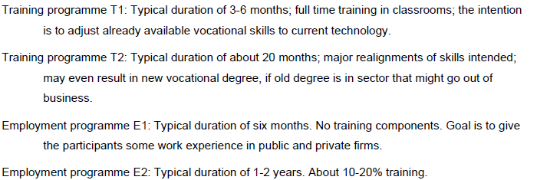
Programmes
Each team may select at least 2 programmes of interest
Always include non-participation

Slide 7
Task | Institutional information
From your discussions with the case workers, you know that clients are allocated randomly to case workers and that case workers decide about the allocation to programmes.
Caseworkers base their decisions primarily on the skill level of the unemployed, employment history, local demand for labour as well as other employment related factors. From past experiences it appears likely that case workers are more likely to allocate programmes to those ‘who’ need it most (it seems that the individual caseworkers use their own judgement about labour market success without a programme as a guide). Usually, participants learn in the month before the programme about their future participation.

Slide 8
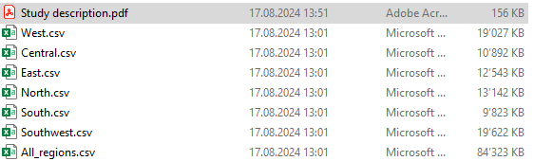
Data from different regions (& country as a whole)
Chose data
The file Study description.pdf contains the description of the data
All data files have the same variables

Slide 9
Joint discussion when all teams have completed their tasks

Slide 10
1 | Introduction
2 | Task & organisation
3 | Conceptional work: Outcomes (Y) & treatment (D), confounders (X), heterogeneity (Z)
4 | Data download, data cleaning & definition of population of interest
5 | Effect estimation: Implementation & interpretation of the results
6 | Optimal policy: Implementation & interpretation of the results
7 | Summary & general discussion

Slide 11
Define Y & D, Z, D (without data)
Conceptionally define a treatment variable that you want to use (D)
Conceptionally define outcome variable(s) that you want to use (Y)
Conceptionally define the heterogeneities you are interested in (Z)
Discuss identification
Based on this discussion, define the confounders (X)

Slide 12
Joint discussion when all teams have completed their tasks

Slide 13
1 | Introduction
2 | Task & organisation
3 | Conceptional work: Outcomes (Y) & treatment (D), confounders (X), heterogeneity (Z)
4 | Data download, data cleaning & definition of population of interest
5 | Effect estimation: Implementation & interpretation of the results
6 | Optimal policy: Implementation & interpretation of the results
7 | Summary & general discussion

Slide 14
Data
Download your data
Clean the data
Reduce to cover only variables related to Y, D, Z, X
Check for missing & implausible values
In the current version, missing values (e.g., NaN) may lead to problems for mcf estimation
Clean data in an appropriate way
Reduce data to the subpopulation of interest
Remove observations relating to treatments that are not of interest

Slide 15
Joint discussion when all teams have completed their tasks

Slide 16
1 | Introduction
2 | Task & organisation
3 | Conceptional work: Outcomes (Y) & treatment (D), confounders (X), heterogeneity (Z)
4 | Data download, data cleaning & definition of population of interest
5 | Effect estimation: Implementation & interpretation of the results
6 | Optimal policy: Implementation & interpretation of the results
7 | Summary & general discussion

Slide 17
Effects estimation
Common support?
Implication of the results
ATE
GATE
IATE analysis: Any additional heterogeneity
Did the programmes (not) work?
Long run vs. short run
On average?
Who was positively and/or negatively affected by the programmes?

Slide 18
Joint discussion when all teams have completed their tasks
Please share your most relevant results

Slide 19
1 | Introduction
2 | Task & organisation
3 | Conceptional work: Outcomes (Y) & treatment (D), confounders (X), heterogeneity (Z)
4 | Data download, data cleaning & definition of population of interest
5 | Effect estimation: Implementation & interpretation of the results
6 | Optimal policy: Implementation & interpretation of the results
7 | Summary & general discussion

Slide 20
Optimal allocation
Obtain an optimal allocation
Select an allocation method of your choice
Consider the pro’s & con’s of the different methods
Evaluate the quality of your allocation rule compared to …
the actual allocation
a random allocation
Use a sample splitting approach for …
training the policy score
obtaining the allocation rule
evaluating the allocation rule

Slide 21
Joint discussion when all teams have completed their tasks
Please share your most relevant results

Slide 22

1 | Introduction
2 | Task & organisation
3 | Conceptional work: Outcomes (Y) & treatment (D), confounders (X), heterogeneity (Z)
4 | Data download, data cleaning & definition of population of interest
5 | Effect estimation: Implementation & interpretation of the results
6 | Optimal policy: Implementation & interpretation of the results
7 | Summary & general discussion

Slide 23
Discussion
Any topics that have not yet been discussed in sufficient depth

Slide 24
Tomorrow
Use what we have learned in the last 4 days to define a workplan for the real programme evaluation
Michael Lechner
Swiss Institute for Empirical Economic Research (SEW) University of St. Gallen | Switzerland

